Slide 1
WINDOWS REVERSE ENGINEER
Basic through Advanced Development Path

Slide 2
Basic Reverse Engineering Path
IA-32 Assembly Language
Debugger
Memory Management
Processes / Threads
TOOLS
SKILLSETS
REVERSE ENGINEER

Slide 3
Memory Management (Basic)
What you need to know about Windows Memory Management at the Basic Level
It is very dependent upon the hardware platform it is executing on.
Modern operating systems use virtual memory.
The PAGE is the smallest memory block that the Memory Manager uses.
The memory manager has two primary tasks
Translating, or mapping, a process’s virtual address space into physical memory
Paging some of the contents of memory to disk when it becomes overcommitted
Back

Slide 4
Memory Management (Basic)
It is very dependent upon the hardware platform it is executing on
This is true for all operating systems. Memory Management is defined by the hardware.
Memory Management must be extremely fast and efficient. This is possible because the hardware defines what the Memory Manager must do.
Back

Slide 5
Memory Management (Basic)
Windows uses virtual memory
The virtual size of a process on 32-bit Windows is 2 GB. A 32-bit process can grow to be 3 GB on 32-bit Windows and to 4 GB on 64-bit Windows.
The process virtual address space size on 64-bit Windows is 7,152 GB on IA64 systems and 8,192 GB on x64 systems.
What makes the memory virtual is a local fixed disk is used as part of the computer’s memory. A microprocessor can’t execute memory directly from a fixed disk. First, it must copy ‘stale’ memory to the paging file and then overwrite this ‘stale’ memory with memory in the paging file that is needed for execution.
Back

Slide 6
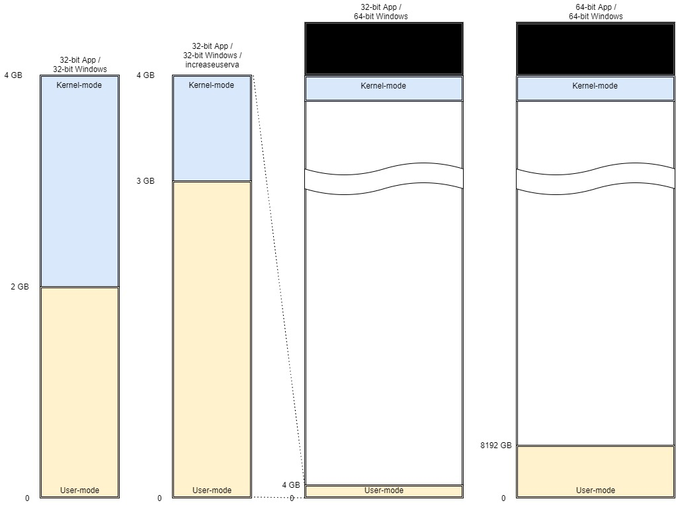
Memory Management (Basic)
Back

Slide 7
Memory Management (Basic)
The Memory Manager provides a core set of services on which the various Windows environment subsystems are built
memory mapped files (internally called section objects)
copy-on-write memory
support for applications using large, sparse address spaces
provides a way for a process to allocate and use larger amounts of physical memory than can be mapped into the process virtual address space at one time
Back

Slide 8
Memory Management (Basic)
Memory Mapped Files (Section Objects)
Represents a block of memory that two or more processes can share.
Can be mapped to the paging file or to another file on disk.
Executive uses sections to load executable images into memory.
Cache Manager uses them to access data in a cached file.
Use section objects to map a file into a process space.
The file can then be accessed as a large array by mapping different views of the section object and reading or writing to memory rather than to the file (an activity called mapped file I/O).
When the program accesses an invalid page (one not in physical memory), a page fault occurs and the memory manager automatically brings the page into memory from the mapped file (or page file).
If the application modifies the page, the memory manager writes the changes back to the file during its normal paging operations.
The application can flush a view by using the Windows FlushViewOfFile function.
Back

Slide 9
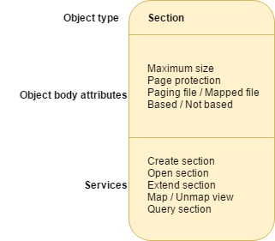
Memory Management (Basic)
Section Objects
Allocated and deallocated by the object manager.
The object manager creates and initializes an object header, which it uses to manage the objects.
The memory manager defines the body of the section object and implements services that user-mode threads can call to retrieve and change the attributes stored in the body of section objects.
Back

Slide 10
Memory Management (Basic)
Section Objects – Object Body Attributes
Attribute | Purpose
Maximum size | The largest size to which the section can grow in bytes; if mapping a file, the maximum size is the size of the file.
Page protection | Page-based memory protection assigned to all pages in the section when it is created.
Paging file/Mapped file | Indicates whether the section is created empty (backed by the paging file—as explained earlier, page-file-backed sections use page-file resources only when the pages need to be written out to disk) or loaded with a file (backed by the mapped file).
Based/Not based | Indicates whether a section is a based section, which must appear at the same virtual address for all processes sharing it, or a non-based section, which can appear at different virtual addresses for different processes.
Back

Slide 11
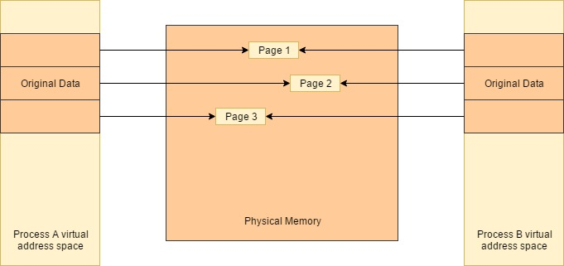
Memory Management (Basic)
Copy On Write Page Protection
Copy on write page protection is an optimization the memory manager uses to conserve physical memory. When a process maps a copy-on-write view of a section object that contains read/write pages, instead of making a process private copy at the time the view is mapped, the memory manager defers making a copy of the pages until the page is written to.
Back

Slide 12
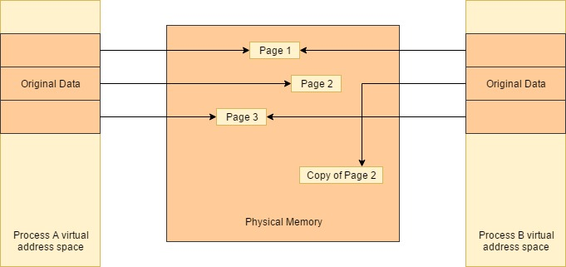
Memory Management (Basic)
Copy On Write Page Protection
If a thread in either process writes to a page, a memory management fault is generated. The memory manager sees that the write is to a copy-on-write page, so instead of reporting the fault as an access violation, it allocates a new read/write page in physical memory, copies the contents of the original page to the new page, updates the corresponding page-mapping information in this process to point to the new location, and dismisses the exception, thus causing the instruction that generated the fault to be re-executed.
Back

Slide 13
Memory Management (Basic)
The virtual address space is divided into units called pages. That is because the hardware memory management unit translates virtual to physical addresses at the granularity of a page. Hence, a page is the smallest unit of protection at the hardware level.
The processors on which Windows runs support two page sizes, called small and large. The actual sizes vary based on the processor architecture.
The primary advantage of large pages is speed of address translation for references to other data within the large page. This advantage exists because the first reference to any byte within a large page will cause the hardware’s translation look-aside buffer to have in its cache the information necessary to translate references to any other byte within the large page.
To determine the size of a page and the allocation granularity on the host computer, use the GetSystemInfo function.
Back

Slide 14
Processes / Threads (Basic)
What you need to know about Processes / Threads at the Basic Level
A Windows process comprises the following:
A private virtual address space, which is a set of virtual memory addresses that the process can use.
An executable program, which defines initial code and data and is mapped into the process’ virtual address space.
A list of open handles to various system resources—such as semaphores, communication ports, and files—that are accessible to all threads in the process.
A security context called an access token that identifies the user, security groups, privileges, User Account Control (UAC) virtualization state, session, and limited user account state associated with the process.
A unique identifier called a process ID (internally part of an identifier called a client ID).
At least one thread of execution (although an “empty” process is possible, it is not useful).
Back

Slide 15
Processes / Threads (Basic)
A private virtual address space, which is a set of virtual memory addresses that the process can use.
Physical Memory Pages
A portion of Process A’s private virtual address space
0x00401000
0x00402000
0x00403000
0x00404000
0x00405000
A portion of Process B’s private virtual address space
0x00401000
0x00402000
0x00403000
0x00404000
0x00405000
Back

Slide 16
Processes / Threads (Basic)
An executable program, which defines initial code and data and is mapped into the process’ virtual address space
Back

Slide 17
Processes / Threads (Basic)
What you need to know about Processes / Threads at the Basic Level
Each Windows process is represented by an executive process (EPROCESS) structure.
The EPROCESS and most of its related data structures exist in system address space.
One exception is the process environment block (PEB), which exists in the process address space (because it contains information accessed by user-mode code)
For each process that is executing a Win32 program, the Win32 subsystem process (Csrss) maintains a parallel structure called the CSR_PROCESS.
The kernel-mode part of the Win32 subsystem (Win32k.sys) maintains a per-process data structure, W32PROCESS. The W32PROCESS structure is created the first time a thread calls a Windows USER or GDI function that is implemented in kernel mode.
Back

Slide 18
Processes / Threads (Basic)
With the exception of the idle process, every EPROCESS structure is encapsulated as a process object by the executive object manager.
Because processes are not named objects, they are not visible in the SysInternals Suite tool WinObj. You can, however, see the Type object called “Process” in the \ObjectTypes directory.
A handle to a process provides, through use of the process-related APIs, access to some of the data in the EPROCESS structure and also in some of its associated structures.
Back

Slide 19
Processes / Threads (Basic)
Process Environment Block (PEB)
Thread Environment Block (TEB)
Process Address Space
System Address Space
Process Object
Win32k process structure
Thread Object
…
Back

Slide 20
IA-32 Assembly Language (Basic)
What you need to know about IA-32 Assembly Language at the Basic Level
It is the lowest level language to the hardware.
The microprocessor/microcontroller manufacturers provide excellent documentation for writing software for their products.
As a reverse engineer, you read assembly language code.
The biggest difficulty is dealing with compiler optimizations and obfuscations.
A lack of symbol files for the code you are reversing increases the detective work on your part.
Back

Slide 21
Debugger (Basic)
What you need to know about a Debugger at the Basic Level
Provides you with an active view of a currently running program.
In user-mode, there are a variety of debuggers from which to choose.
In kernel-mode, there is an obvious choice for Windows – WinDbg.
Symbol file locations must be made aware to the debugger.
The trace command (t) and the step command (p) are two important commands to learn.
This is followed by the various dump memory and registers commands.
Back

Slide 22
Intermediate Reverse Engineering Path
Dumpbin
Depends
Hex Editor
IA-32 Assembly Language
DLL’s (Dynamic Link Libraries)
Debugger
IDA Pro
Memory Management
Processes / Threads
TOOLS
SKILLSETS
REVERSE ENGINEER

Slide 23
Memory Management (Intermediate)
What you need to know about Windows Memory Management at the Intermediate Level
The memory manager has two primary tasks
Translating, or mapping, a process’s virtual address space into physical memory
Paging some of the contents of memory to disk when it becomes overcommitted
Back

Slide 24
Memory Management (Intermediate)
kd> rM 0x100
gdtr=82430000 gtdl=03ff idtr=82430400 idtl=07ff tr=0028 ldtr=0000
Bit | Value | Description
0 1 | 0x1 0x2 | Displays the basic integer registers. (Setting one or both of these bits has the same effect.)
2 | 0x4 | Displays the floating-point registers.
3 | 0x8 | Displays the segment registers.
4 | 0x10 | Displays the MMX registers.
5 | 0x20 | Displays the debug registers. In kernel mode, setting this bit also displays the CR4 register.
6 | 0x40 | Displays the SSE XMM registers.
7 | 0x80 | (Kernel mode only) Displays the CR0, CR1, and CR3 registers.
8 | 0x100 | (Kernel mode only) Displays the descriptor and task state registers.
Back

Slide 25
Memory Management (Intermediate)
kd> r gdtr
gdtr=82430000
kd> r gdtl
gtdl=03ff
Back

Slide 26
Memory Management (Intermediate)
kd> d 82430000 L3FF
82430000 00 00 00 00 00 00 00 00-ff ff 00 00 00 9b cf 00
82430010 ff ff 00 00 00 93 cf 00-ff ff 00 00 00 fb cf 00
82430020 ff ff 00 00 00 f3 cf 00-ab 20 00 b0 13 8b 00 80
82430030 28 21 00 78 90 93 40 81-ff 0f 00 e0 fa f3 40 7f
82430040 ff ff 00 04 00 f2 00 00-00 00 00 00 00 00 00 00
82430050 68 00 00 50 90 89 00 81-68 00 68 50 90 89 00 81
82430060 00 00 00 00 00 00 00 00-00 00 00 00 00 00 00 00
Back

Slide 27
Memory Management (Intermediate)
kd> dg 0 3F8
P Si Gr Pr Lo
Sel Base Limit Type l ze an es ng Flags
---- -------- -------- ---------- - -- -- -- -- --------
0000 00000000 00000000 <Reserved> 0 Nb By Np Nl 00000000
0008 00000000 ffffffff Code RE Ac 0 Bg Pg P Nl 00000c9b
0010 00000000 ffffffff Data RW Ac 0 Bg Pg P Nl 00000c93
0018 00000000 ffffffff Code RE Ac 3 Bg Pg P Nl 00000cfb
0020 00000000 ffffffff Data RW Ac 3 Bg Pg P Nl 00000cf3
0028 8013b000 000020ab TSS32 Busy 0 Nb By P Nl 0000008b
0030 81907800 00002128 Data RW Ac 0 Bg By P Nl 00000493
0038 7ffae000 00000fff Data RW Ac 3 Bg By P Nl 000004f3
0040 00000400 0000ffff Data RW 3 Nb By P Nl 000000f2
0050 81905000 00000068 TSS32 Avl 0 Nb By P Nl 00000089
0058 81905068 00000068 TSS32 Avl 0 Nb By P Nl 00000089
0070 82430000 000003ff Data RW 0 Nb By P Nl 00000092
00E8 00000000 0000ffff Data RW 0 Nb By P Nl 00000092
00F0 8185eaa4 000003b2 Code EO 0 Nb By P Nl 00000098
00F8 00000000 0000ffff Data RW 0 Nb By P Nl 00000092
…
Back

Slide 28
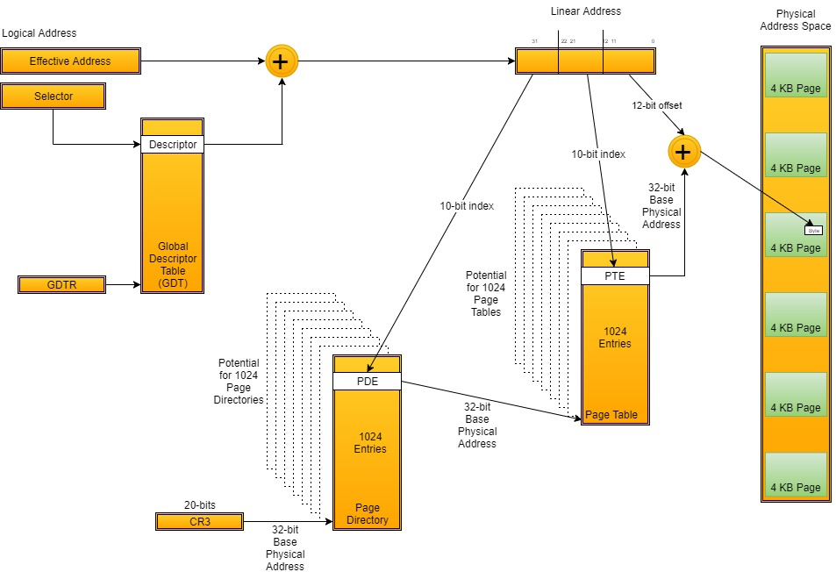
Memory Management (Intermediate)
Back

Slide 29
Processes / Threads (Intermediate)
Back

Slide 30
IA-32 Assembly Language (Intermediate)
Reserved bit positions. DO NOT USE.
Always set to values previously read.
31
30
29
28
27
26
25
24
23
22
21
20
19
18
17
16
15
14
13
12
11
10
9
8
7
6
5
4
3
2
1
0
0
0
0
0
0
0
0
0
0
0
ID
VIP
VIF
AC
VM
RF
0
NT
I
O
P
L
OF
DF
IF
TF
SF
ZF
0
AF
0
PC
1
CF
S Indicates a Status Flag
C Indicates a Control Flag
X Indicates a System Flag
X
ID Flag
X
Virtual Interrupt Pending
X
Virtual Interrupt Flag
X
Alignment Check / Access Control
X
Virtual-8086 Mode
X
Resume Flag
X
Nested Task
X
I/O Privilege Level
S
Overflow Flag
C
Direction Flag
X
Interrupt Enable Flag
X
Trap Flag
S
Sign Flag
S
Zero Flag
S
Auxiliary Carry Flag
S
Parity Flag
S
Carry Flag
Back

Slide 31
IA-32 Assembly Language (Intermediate)
The status flags (bits 0, 2, 4, 6, 7, and 11) of the EFLAGS register indicate the results of arithmetic instructions, such as the ADD, SUB, MUL, and DIV instructions. The status flag functions are:
CF (bit 0) Carry flag — Set if an arithmetic operation generates a carry or a borrow out of the most significant bit of the result; cleared otherwise. This flag indicates an overflow condition for unsigned-integer arithmetic. It is also used in multiple-precision arithmetic.
PF (bit 2) Parity flag — Set if the least-significant byte of the result contains an even number of 1 bits; cleared otherwise.
AF (bit 4) Auxiliary Carry flag — Set if an arithmetic operation generates a carry or a borrow out of bit 3 of the result; cleared otherwise. This flag is used in binary-coded decimal (BCD) arithmetic.
ZF (bit 6) Zero flag — Set if the result is zero; cleared otherwise.
SF (bit 7) Sign flag — Set equal to the most-significant bit of the result, which is the sign bit of a signed integer. (0 indicates a positive value and 1 indicates a negative value.)
OF (bit 11) Overflow flag — Set if the integer result is too large a positive number or too small a negative number (excluding the sign-bit) to fit in the destination operand; cleared otherwise. This flag indicates an overflow condition for signed-integer (two’s complement) arithmetic.
Of these status flags, only the CF flag can be modified directly, using the STC, CLC, and CMC instructions. Also the bit instructions (BT, BTS, BTR, and BTC) copy a specified bit into the CF flag.
Back

Slide 32
IA-32 Assembly Language (Intermediate)
The status flags allow a single arithmetic operation to produce results for three different data types:
unsigned integers the CF flag indicates an out-of-range condition (carry or a borrow)
signed integers the OF flag indicates a carry or borrow
BCD integers the AF flag indicates a carry or borrow
The SF flag indicates the sign of a signed integer. The ZF flag indicates either a signed-integer or an unsigned-integer zero.
Back

Slide 33
IA-32 Assembly Language (Intermediate)
When performing multiple-precision arithmetic on integers, the CF flag is used in conjunction with the add with carry (ADC) and subtract with borrow (SBB) instructions to propagate a carry or borrow from one computation to the next.
The condition instructions Jcc (jump on condition code cc), SETcc (byte set on condition code cc), LOOPcc, and CMOVcc (conditional move) use one or more of the status flags as condition codes and test them for branch, setbyte, or end-loop conditions.
The direction flag (DF, located in bit 10 of the EFLAGS register) controls string instructions (MOVS, CMPS, SCAS, LODS, and STOS). Setting the DF flag causes the string instructions to auto-decrement (to process strings from high addresses to low addresses). Clearing the DF flag causes the string instructions to auto-increment (process strings from low addresses to high addresses).
The STD and CLD instructions set and clear the DF flag, respectively.
Back

Slide 34
IA-32 Assembly Language (Intermediate)
The system flags and IOPL field in the EFLAGS register control operating-system or executive operations. They should not be modified by application programs. The functions of the system flags are as follows:
TF (bit 8) Trap flag — Set to enable single-step mode for debugging; clear to disable single-step mode.
IF (bit 9) Interrupt enable flag — Controls the response of the processor to maskable interrupt requests. Set to respond to maskable interrupts; cleared to inhibit maskable interrupts.
IOPL (bits 12 and 13) I/O privilege level field — Indicates the I/O privilege level of the currently running program or task. The current privilege level (CPL) of the currently running program or task must be less than or equal to the I/O privilege level to access the I/O address space. The POPF and IRET instructions can modify this field only when operating at a CPL of 0.
NT (bit 14) Nested task flag — Controls the chaining of interrupted and called tasks. Set when the current task is linked to the previously executed task; cleared when the current task is not linked to another task.
RF (bit 16) Resume flag — Controls the processor’s response to debug exceptions.
VM (bit 17) Virtual-8086 mode flag — Set to enable virtual-8086 mode; clear to return to protected mode without virtual-8086 mode semantics.
AC (bit 18) Alignment check (or access control) flag — If the AM bit is set in the CR0 register, alignment checking of user-mode data accesses is enabled if and only if this flag is 1. If the SMAP bit is set in the CR4 register, explicit supervisor-mode data accesses to user-mode pages are allowed if and only if this bit is 1. See Section 4.6, “Access Rights,” in the Intel® 64 and IA-32 Architectures Software Developer’s Manual, Volume 3A.
VIF (bit 19) Virtual interrupt flag — Virtual image of the IF flag. Used in conjunction with the VIP flag. (To use this flag and the VIP flag the virtual mode extensions are enabled by setting the VME flag in control register CR4.)
VIP (bit 20) Virtual interrupt pending flag — Set to indicate that an interrupt is pending; clear when no interrupt is pending. (Software sets and clears this flag; the processor only reads it.) Used in conjunction with the VIF flag.
ID (bit 21) Identification flag — The ability of a program to set or clear this flag indicates support for the CPUID instruction.
Back

Slide 35
IA-32 Assembly Language (Intermediate)
‘push’ via compiler
Function A Parameter 1
ebp+0x0C
‘push’ via compiler
Function A Parameter 2
ebp+0x08
Intel micro-code
Function A’s Return Address
‘push’ via compiler
Stack Frame Pointer
Points to previous stack frame
‘push’ via compiler
Exception Handler Frame
Subtract 0x18 from esp for local allocation on stack then fill in ebp-0x08, ebp-0x0C or ebp-0x10 to fill in local variables
Function B’s Local Variable 1
ebp-0x08
Function B’s Local Variable 2
ebp-0x0C
Function B’s Local Variable 3
ebp-0x10
‘push’ via compiler
Function B Saved Register 1
‘push’ via compiler
Function B Saved Register 2
‘push’ via compiler
Function B Parameter 1
Intel micro-code
Function B’s Return Address
‘push’ via compiler
Stack Frame Pointer
Points to previous stack frame
‘push’ via compiler
Exception Handler Frame
Function C’s Local Variable 1
Back

Slide 36
DLL’s (Dynamic Link Libraries) (Intermediate)
Back

Slide 37
Debugger (Intermediate)
Back

Slide 38
IDA Pro (Intermediate)
Back

Slide 39
Depends (Intermediate)
Back

Slide 40
Hex Editor (Intermediate)
Back

Slide 41
Dumpbin (Intermediate)
Back

Slide 42
Advanced Reverse Engineering Path
PE Browse
Channel 9
Java / C#
Dumpbin
SysInternals Suite
Windows Internals
C / C++
Depends
Hex Editor
IA-32 Assembly Language
DLL’s (Dynamic Link Libraries)
Debugger
IDA Pro
Memory Management
Processes / Threads
TOOLS
SKILLSETS
REVERSE ENGINEER

Slide 43
Memory Management
Back

Slide 44
Processes / Threads
The pointer to the EPROCESS structure for the system process is stored in nt!PsInitialSystemProcess and that of the SystemIdle process is stored nt!PsIdleProcess.
The ActiveProcessLink field is used to maintain the EPROCESS structure is the list of processes in the system, and the head of this list is kept in the kernel variable nt!PsActiveProcessHead.
The SessionProcessLinks field is used to link the EPROCESS structure to a list of processes in a session whose list head is in MM_SESSION_SPACE.ProcessList.
The JobLinks field is used to link the EPROCESS to a list of processes that are a part of a job whose list head is in EJOB.ProcessListHead.
The memory manager global variable MmProcessList maintains a list of processes using the MmProcessLinks field. This list is traversed by MiReplicatePteChange() to update the kernel mode portion of the process's virtual address space.
Back

Slide 45
Processes / Threads
A list of all threads that belong to a process is maintained in ThreadListHead in which threads are queued via ETHREAD.ThreadListEntry.
The kernel variable ExpTimerResolutionListHead maintains a list of processes that have called NtSetTimerResolution() to change the timer interval. This list is used by ExpUpdateTimerResolution() to update the time resolution to the lowest requested value amongst all the processes.
The "!process" command displays information from the EPROCESS structure. The ".process" command switches the debugger's virtual address space context to that of a particular process, this is a very critical step when examining user mode virtual address in a complete kernel dump or while live debugging a system using a kernel debugger.
Back

Slide 46
IA-32 Assembly Language
Back

Slide 47
DLL’s (Dynamic Link Libraries)
Back

Slide 48
Windows Internals
Back

Slide 49
C / C++
Back

Slide 50
Java / C#
Back

Slide 51
Debugger
Back

Slide 52
IDA Pro
Back

Slide 53
Depends
Back

Slide 54
Hex Editor
Back

Slide 55
Dumpbin
Back

Slide 56
SysInternals Suite
Suite of software tools that are very helpful with troubleshooting and reversing Windows code.
Some of the tools use the command line, while others use a GUI.
Back

Slide 57
SysInternals Suite
Name | Description
AccessChk | AccessChk is a command-line tool for viewing the effective permissions on files, registry keys, services, processes, kernel objects, and more.
AccessEnum | This simple yet powerful security tool shows you who has what access to directories, files and Registry keys on your systems. Use it to find holes in your permissions.
AdExplorer | Active Directory Explorer is an advanced Active Directory (AD) viewer and editor.
AdInsight | An LDAP (Light-weight Directory Access Protocol) real-time monitoring tool aimed at troubleshooting Active Directory client applications.
AdRestore | Undelete Server 2003 Active Directory objects.
Autologon | Bypass password screen during logon.
Autoruns | See what programs are configured to startup automatically when your system boots and you login. Autoruns also shows you the full list of Registry and file locations where applications can configure auto-start settings.
BgInfo | This fully-configurable program automatically generates desktop backgrounds that include important information about the system including IP addresses, computer name, network adapters, and more.
Back

Slide 58
SysInternals Suite
Name | Description
BlueScreen | This screen saver not only accurately simulates Blue Screens, but simulated reboots as well (complete with CHKDSK), and works on Windows NT 4, Windows 2000, Windows XP, Server 2003 and Windows 95 and 98.
CacheSet | CacheSet is a program that allows you to control the Cache Manager's working set size using functions provided by NT. It's compatible with all versions of NT.
ClockRes | View the resolution of the system clock, which is also the maximum timer resolution.
Contig | Wish you could quickly defragment your frequently used files? Use Contig to optimize individual files, or to create new files that are contiguous.
Coreinfo | Coreinfo is a new command-line utility that shows you the mapping between logical processors and the physical processor, NUMA node, and socket on which they reside, as well as the cache’s assigned to each logical processor.
Ctrl2cap | This is a kernel-mode driver that demonstrates keyboard input filtering just above the keyboard class driver in order to turn caps-locks into control keys. Filtering at this level allows conversion and hiding of keys before NT even "sees" them. Ctrl2cap also shows how to use NtDisplayString() to print messages to the initialization blue-screen.
Back

Slide 59
SysInternals Suite
Name | Description
DebugView | Another first from Sysinternals: This program intercepts calls made to DbgPrint by device drivers and OutputDebugString made by Win32 programs. It allows for viewing and recording of debug session output on your local machine or across the Internet without an active debugger.
Desktops | This new utility enables you to create up to four virtual desktops and to use a tray interface or hotkeys to preview what’s on each desktop and easily switch between them.
Disk2vhd | Disk2vhd simplifies the migration of physical systems into virtual machines (p2v)
DiskExt | Display volume disk-mappings.
Diskmon | This utility captures all hard disk activity or acts like a software disk activity light in your system tray.
DiskView | Graphical disk sector utility.
DiskUsage (DU) | View disk usage by directory.
EFSDump | View information for encrypted files.
Back

Slide 60
SysInternals Suite
Name | Description
FindLinks | FindLinks reports the file index and any hard links (alternate file paths on the same volume) that exist for the specified file. A file's data remains allocated so long as at it has at least one file name referencing it.
Handle | This handy command-line utility will show you what files are open by which processes, and much more.
Hex2dec | Convert hex numbers to decimal and vice versa.
Junction | Create Win2K NTFS symbolic links.
LDMDump | Dump the contents of the Logical Disk Manager's on-disk database, which describes the partitioning of Windows 2000 Dynamic disks.
ListDLLs | List all the DLLs that are currently loaded, including where they are loaded and their version numbers.
LiveKd | Use Microsoft kernel debuggers to examine a live system.
LoadOrder | See the order in which devices are loaded on your WinNT/2K system.
LogonSessions | List the active logon sessions on a system.
Back

Slide 61
SysInternals Suite
Name | Description
MoveFile | Allows you to schedule move and delete commands for the next reboot.
NotMyfault | Notmyfault is a tool that you can use to crash, hang, and cause kernel memory leaks on your Windows system.
NTFSInfo | Use NTFSInfo to see detailed information about NTFS volumes, including the size and location of the Master File Table (MFT) and MFT-zone, as well as the sizes of the NTFS meta-data files.
PendMoves | Enumerate the list of file rename and delete commands that will be executed the next boot.
PipeList | Displays the named pipes on your system, including the number of maximum instances and active instances for each pipe.
PortMon | Monitor serial and parallel port activity with this advanced monitoring tool. It knows about all standard serial and parallel IOCTLs and even shows you a portion of the data being sent and received. Version 3.x has powerful new UI enhancements and advanced filtering capabilities.
ProcDump | This command-line utility is aimed at capturing process dumps of otherwise difficult to isolate and reproduce CPU spikes. It also serves as a general process dump creation utility and can also monitor and generate process dumps when a process has a hung window or unhandled exception.
Back

Slide 62
SysInternals Suite
Name | Description
Process Explorer | Find out what files, registry keys and other objects processes have open, which DLLs they have loaded, and more. This uniquely powerful utility will even show you who owns each process.
Process Monitor | Monitor file system, Registry, process, thread and DLL activity in real-time.
PsExec | Execute processes on remote systems.
PsFile | See what files are opened remotely.
PsGetSid | Displays the SID of a computer or a user.
PsInfo | Obtain information about a system.
PsKill | Terminate local or remote processes.
PsPing | Measure network performance.
PsList | Show information about processes and threads.
PsLoggedOn | Show users logged on to a system.
PsLogList | Dump event log records.
PsPassword | Changes account passwords.
Back

Slide 63
SysInternals Suite
Name | Description
PsService | View and control services.
PsShutdown | Shuts down and optionally reboots a computer
PsSuspend | Suspend and resume processes.
PsTools | The PsTools suite includes command-line utilities for listing the processes running on local or remote computers, running processes remotely, rebooting computers, dumping event logs, and more.
RAMMap | An advanced physical memory usage analysis utility that presents usage information in different ways on its several different tabs.
RegDelNull | Scan for and delete Registry keys that contain embedded null-characters that are otherwise undeleteable by standard Registry-editing tools.
Registry Usage (RU) | View the registry space usage for the specified registry key.
RegJump | Jump to the registry path you specify in Regedit.
Back

Slide 64
SysInternals Suite
Name | Description
Sdelete | Securely overwrite your sensitive files and cleanse your free space of previously deleted files using this DoD-compliant secure delete program.
ShareEnum | Scan file shares on your network and view their security settings to close security holes.
ShellRunas | Launch programs as a different user via a convenient shell context-menu entry.
Sigcheck | Dump file version information and verify that images on your system are digitally signed.
Streams | Reveal NTFS alternate streams.
Strings | Search for ANSI and UNICODE strings in binary images.
Sync | Flush cached data to disk.
Sysmon | Monitors and reports key system activity via the Windows event log
TCPView | Active socket command-line viewer.
VMMap | VMMap is a process virtual and physical memory analysis utility.
VolumeId | Set Volume ID of FAT or NTFS drives.
Whois | See who owns an Internet address.
Back

Slide 65
SysInternals Suite
Name
WinObj | The ultimate Object Manager namespace viewer is here.
ZoomIt | Presentation utility for zooming and drawing on the screen.
Back

Slide 66
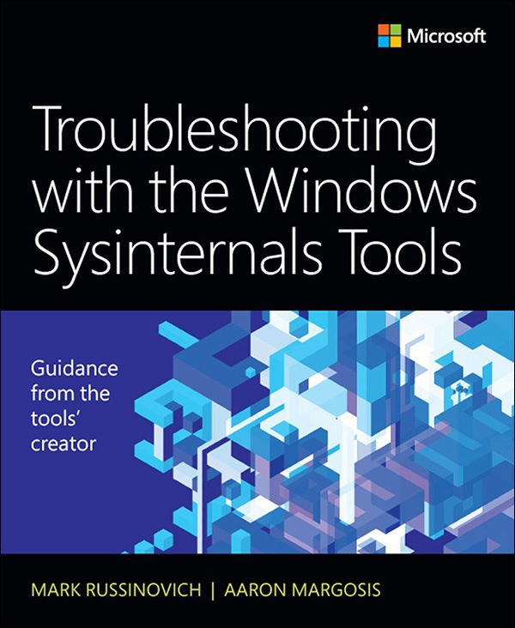
SysInternals Suite
Back

Slide 67
PE Browse
Back

Slide 68
Channel 9
https://channel9.msdn.com/
Huge library of videos featuring Microsoft employees discussing Microsoft products.
Reverse engineers should follow Defrag Tools (https://channel9.msdn.com/Shows/Defrag-Tools).
Back

Slide 69
Channel 9
# 1 - Building you USB thumbdrive (optional)
# 2 - Process Explorer
# 3 - Process Monitor
# 4 - Process Monitor – Examples
# 5 - Autoruns and MSConfig
# 6 - RAMMap
# 7 - VMMap
# 13 - WinDbg
# 14 - WinDbg – SOS
# 15 - WinDbg - Bugchecks (BSOD)
# 19 - WinDbg – OCA
# 20 - WinDbg - Basic Commands
# 21 - WinDbg - Memory User Mode
# 22 - WinDbg - Memory Kernel Mode
# 24 - WinDbg - Critical Sections
# 25 - WinDbg – Events
# 26 - WinDbg - Semaphores, Mutexes and Timers
# 27 - WinDbg - Configure Kernel Debugging
# 28 - WinDbg – Scheduling
# 29 - WinDbg - ETW Logging
# 30 - MCTS Windows Internals
# 89 - Symbol Folder Tools
# 94 - Sysinternals Strings, FindStr, !pde.ssz
# 96 - Writing a Debugger Extension Part 1
# 97 - Writing a Debugger Extension Part 2
# 98 - Writing a Debugger Extension Part 3
# 99 - Writing a Debugger Extension Part 4
#101 - Writing a Debugger Extension Part 5
#102 - Writing a Debugger Extension Part 6
#103 - Writing a Debugger Extension Part 7
#104 - Writing a Debugger Extension Part 8
#105 - Writing a Debugger Extension Part 9
Back

Slide 70
Channel 9
#120 - Windows Management Instrumentation (optional)
#121 - DebugDiag Part 1
#122 - DebugDiag Part 2
#123 - DebugDiag Part 3
#124 - DebugDiag Part 4
#134 - Microsoft Symbol Proxy (SymProxy) (optional)
#135 - Debugging User Mode Crash Dumps Part 1
#136 - Debugging User Mode Crash Dumps Part 2
#137 - Debugging Kernel Mode Crashes and Hangs
#138 - Debugging - 'dx' Command Part 1
#139 - Debugging - 'dx' Command Part 2
#146 – WinDiff
#147 - Dependency Walker
#154 - Memory Footprint and Leaks
#161 - Troubleshooting a Slow PC (optional)
#167 - Debugging User Mode Crash Dumps Redux
#169 - Debugging Tools for Windows Team (optional)
#172 - Application Hangs
#173 - Troubleshooting with the Windows
#175 - Debugging the Network Stack
Back

